Slide 1
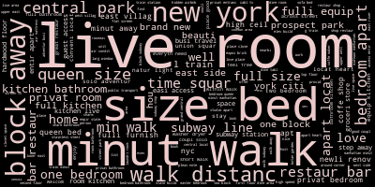
DSC190 Data Mining Challenge
Feature Engineering & Model Selection Explained
By Wenqian Zhao
Team name: Yellow Braised Chicken Xiaozi

Slide 2
General Approach
Feature Engineering
Use as many as features as possible.
Create new features based on the existing features.
Not to compress any given information.
To the maximum extent possible, distinguishing the luxury listings with normal listings.
Less imputation based on the features, instead, filling “unknown” or 0 for some missing values.
Model Selection
80% train with 5-fold cv, 20% validation for model performance evaluation with rmse metric.
Stacking multiple models together with manually tuned weights.
Visualize the predicted and actual price to evaluate the model with a greater vision.

Slide 3
Feature
Engineering
Model Selection

Slide 4
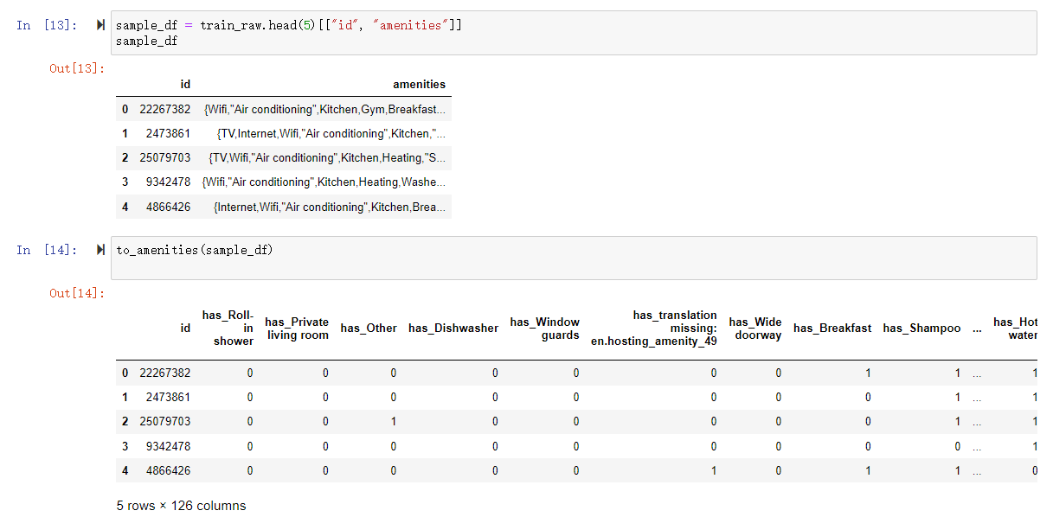
Feature Engineering Examples - amenities

Slide 5
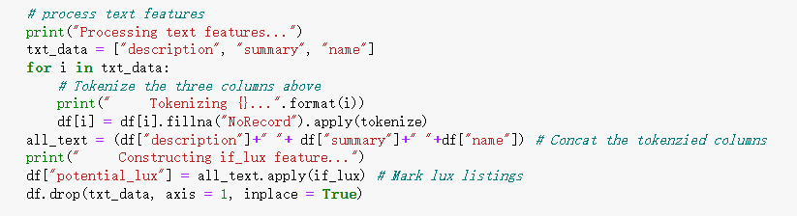
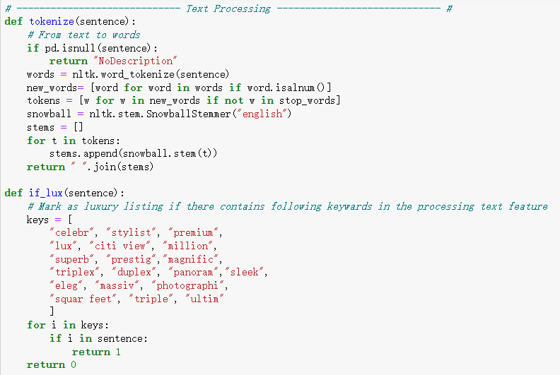
Feature Engineering Example - Text
import nltk
from nltk.tokenize import word_tokenize
from nltk.corpus import stopwords
stop_words = set(stopwords.words('english'))

Slide 6
Model Selection
Model used:
CatboostRegressor (n_estimators=1000, max_depth=8, metric_period = 250, loss_function="RMSE")
LightGBM(max_depth=18, min_data_in_leaf = 23, num_leaves = 50)
XgBoost(max_depth=14, learning_rate=0.1, n_estimators=100, min_child_weight = 10)
Weights:
CBR → 0.5
LGBM → 0.4
XGB → 0.1

Slide 7
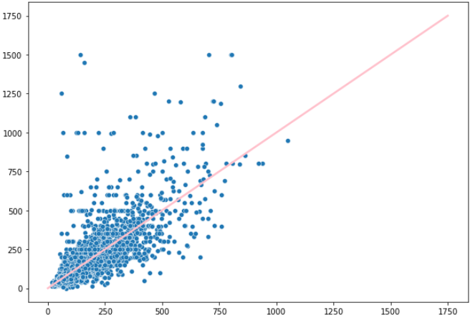
Prediction vs. Observation Visualization

Slide 8
Learn From Failures
TF-IDF Vectorizer with min_df = 0.05 and max_features = 1000
Mode Imputation
Categorize minorities to “Other” → property types
“transit” Specification → has_bus, has_taxi, has_subway…
SMOGN - a Pre-processing Approach for Imbalanced Regression
http://proceedings.mlr.press/v74/branco17a/branco17a.pdf
…

Slide 9
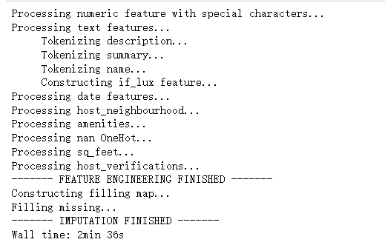
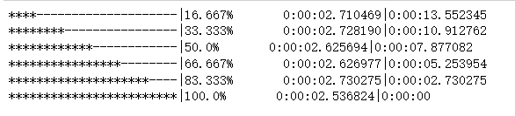
Fun

Slide 10
Thanks for Watching
https://github.com/wenqian-zhao/dsc190-dm-challenge.git

